Slide 1

SMART CANTEEN SYSTEM USING JAVA
2003A51296 B. DURGAPRASAD

Slide 2
OBJECTIVE:
The main objective for developing this Java Project on Smart Canteen System is to provide exception and threads to the login page, table services, and food quantity.
We develop Smart Canteen System for an online food service by creating 2 classes i.e., Menu package and Smart canteen class.

Slide 3
ELEMENTS USED:
The elements we have used for the project are classes and objects, interface, packages, keyword,
STATIC METHOD, CONSTRUCTORS, STRING
METHODS,THREADS,EXCEPTIONS,ACCESSMODIFIERS.

Slide 4
ELEMENTS
Class: A class is a group of objects which have common properties. It is a template or blueprint from which objects are created. It is a logical entity. It can't be physical. Object: An object is an instance of a class. A class is a template or blueprint from which objects are created. So, an object is the instance(result) of a class. Packages: A package is nothing but a physical folder structure (directories) that contains a group of related classes, interfaces, and sub-packages according to their functionality. Interface: An interface in Java is a blueprint of a class. It has static constants and abstract methods.

Slide 5
Thread: Threads allows a program to operate more efficiently by doing multiple things at the same time Methods: A method is a block of code or collection of statements or a set of codes grouped together to perform a certain task or operation. It is used to achieve the reusability of code Static method: A static method in Java is a method that is part of a class rather than an instance of that class

Slide 6
Constructor: Java keywords are also known as reserved words. Keywords are particular words that act as a key to a code. These are predefined words by Java so they cannot be used as a variable or object name or class name. Keywords (Final, This, Super): Java keywords are also known as reserved words. Keywords are particular words that act as a key to a code. These are predefined words by Java so they cannot be used as a variable or object name or class name. Access modifier (Default, Private, Public): The access modifiers in Java specify the accessibility or scope of a field, method, constructor, or class. We can change the access level of fields, constructors, methods, and classes by applying the access modifier to them.

Slide 7
String Methods: Java has a lot of String methods that allow us to work with strings. In this reference page, you will find all the string methods available in Java. For example, if you need to find the length of a string, use the length() method.
Exceptions: Exception is an unwanted or unexpected event, which occurs during the execution of a program, i.e. at run time, that disrupts the normal flow of the program’s instructions.

Slide 8
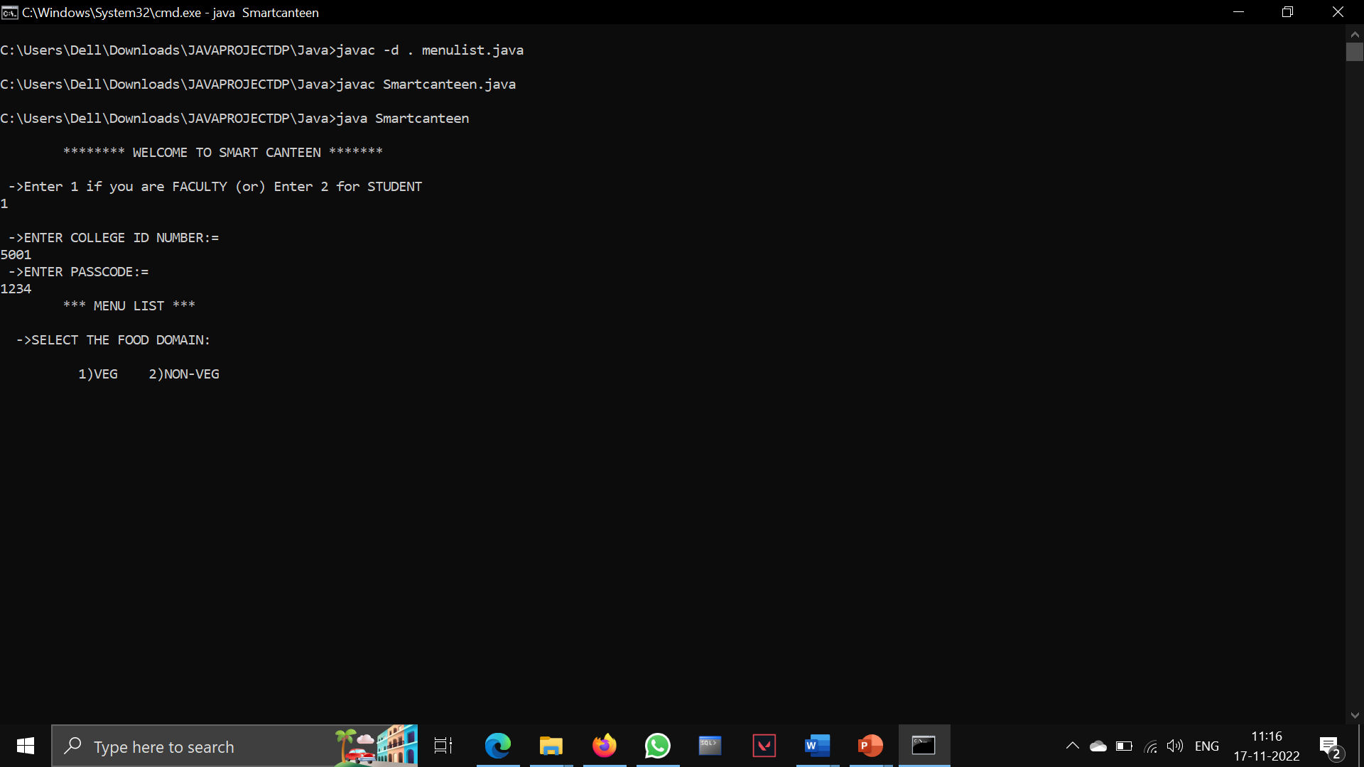
PROJECT OUTPUT Test cases:
TEST CASE -1:
Enter the login Details of Staff or Student

Slide 9
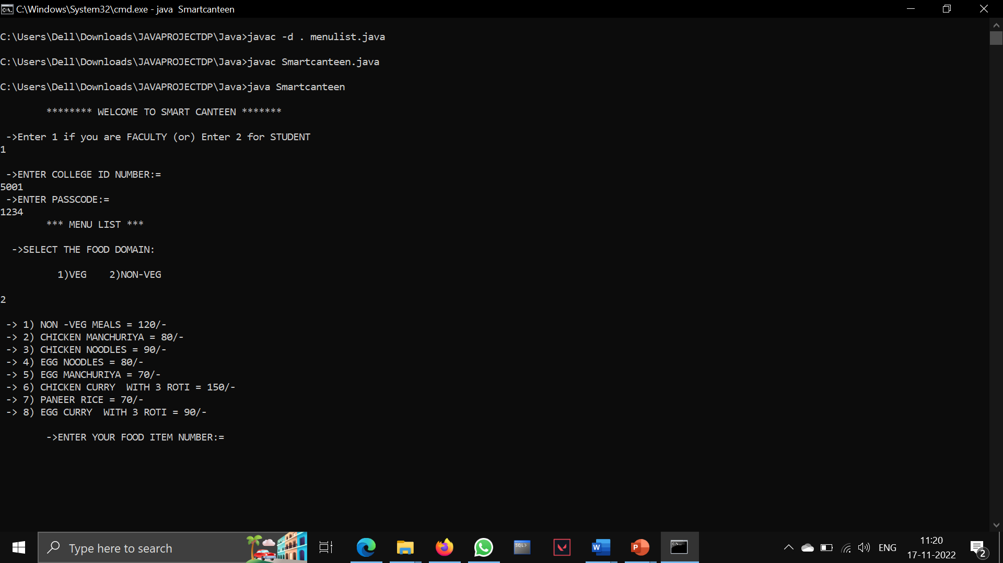
TEST CASE – 2:
Select the Menu List in Food Domain and If you want
Veg press 1 or Non-Veg press 2

Slide 10
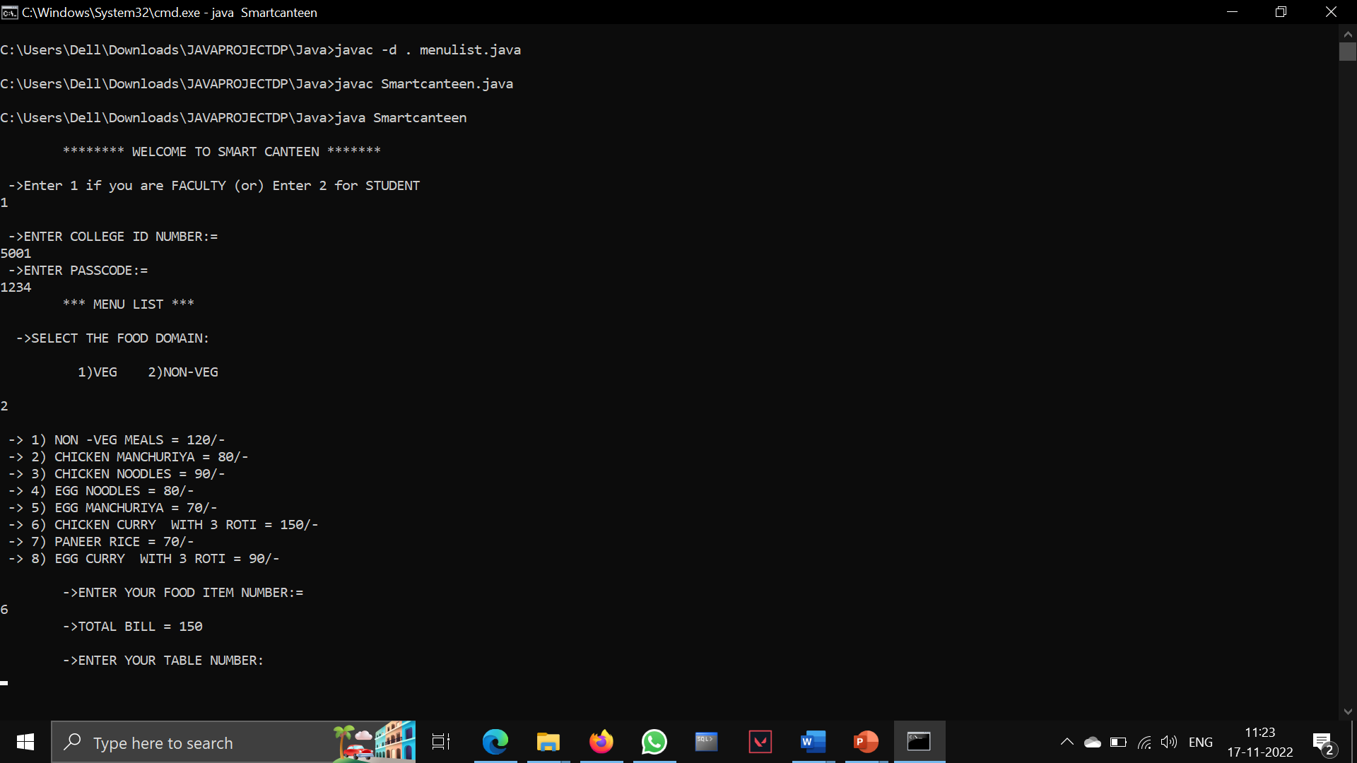
TEST CASE – 3:
In Menu list select your favourite food item number and the item cost will also be added

Slide 11
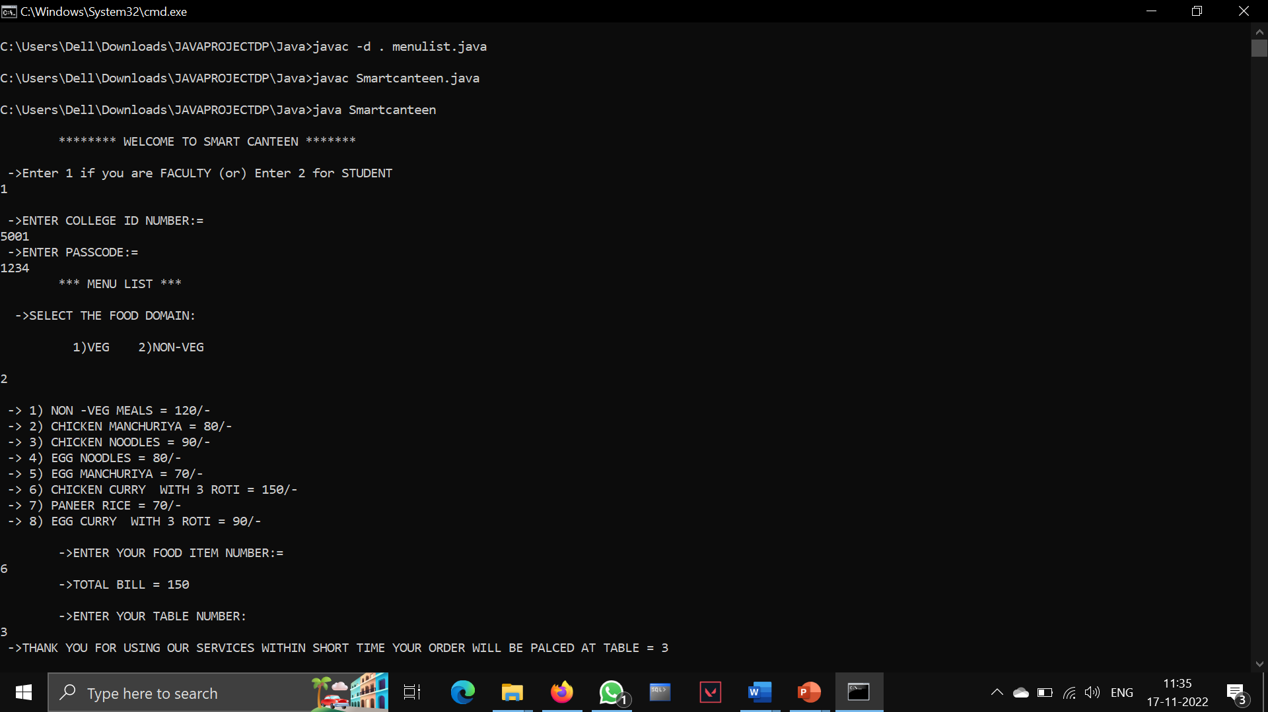
Test Case – 4:
Finally Enter your Table number and confirmed your order.

Slide 12
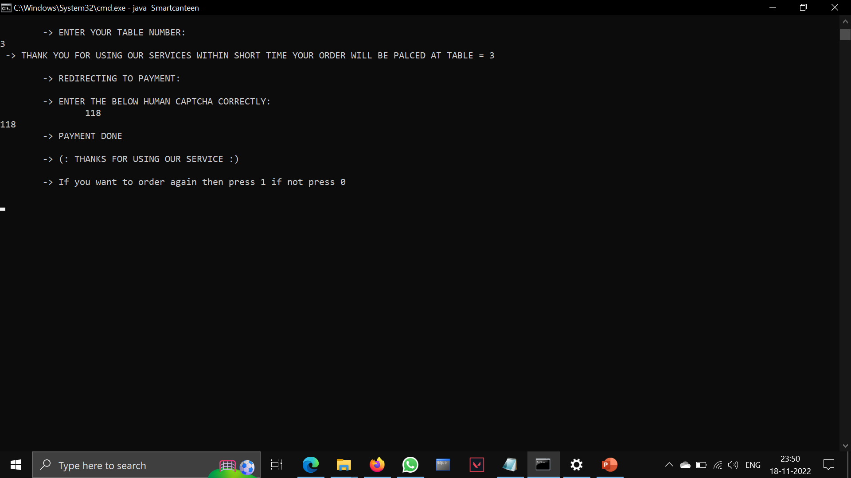
TEST CASE – 5:
Enter the below human Captcha and payment was done
If you want to order again press 1 or exist press 0

Slide 13
CONCLUSION
It will provide fast services to their customers. Usually what happened is people must go to the canteen and order the food items, they must wait in a queue for a long time to get their orders. It will provide a list of different items in the menu list with two different categories. User can select any item from the canteen and can order it online. Users should be able to login with the valid username and password. Users need to enter the username and password to place their order. Also, security is equally important in the system. A user will be able to edit the order. Here, users will be able to add, delete, edit, and clear the food items from their order. It provides an easy user interface. The food items details will be their including the ID, name, and price.

Slide 14
THANK - YOU

